Slide 1

Implementation of Man in the Middle Attack(Ettercap Tool)

Slide 2
TEAM MEMBERS:
K.DIMPLE(2010030436)
K.SIRISHA(2010030438)

Slide 4
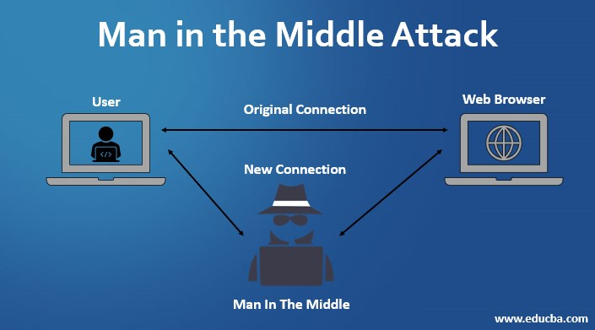

Slide 5
Prerequisites of MITM attack:
The attacker must obtain the following things in order to launch a successful MITM attack:
- Software to perform the attack
- Hardware to perform the attack
- Access to a computer on the targeted computers’ LAN OR
- Access to the targeted computers’ LAN
- Time
- Knowledge of the protocol he wished to manipulate

Slide 6
ARP:
Address Resolution Protocol:
ARP is used to find out the MAC Address of a particular device whose IP address is known.
ARP spoofing is a Man In The Middle (MITM) attack in which the attacker (hacker) sends forged ARP Messages. This allows the attacker to pretend as a legitimate user as it links the attacker machine’s MAC Address to the legitimate IP Address.

Slide 7
TOOLS:
Ettercap:
By using tools like Ettercap you can easily detected manipulation of ARP entries. Ettercap has a built in detection mechanism which allows you to easily spot ARP changes and react accordingly.

Slide 8
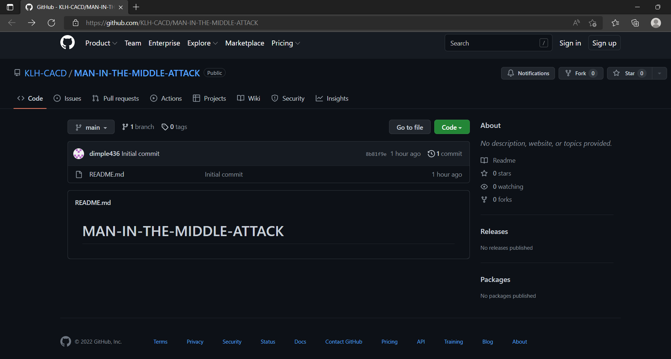
GITHUB:

Slide 9
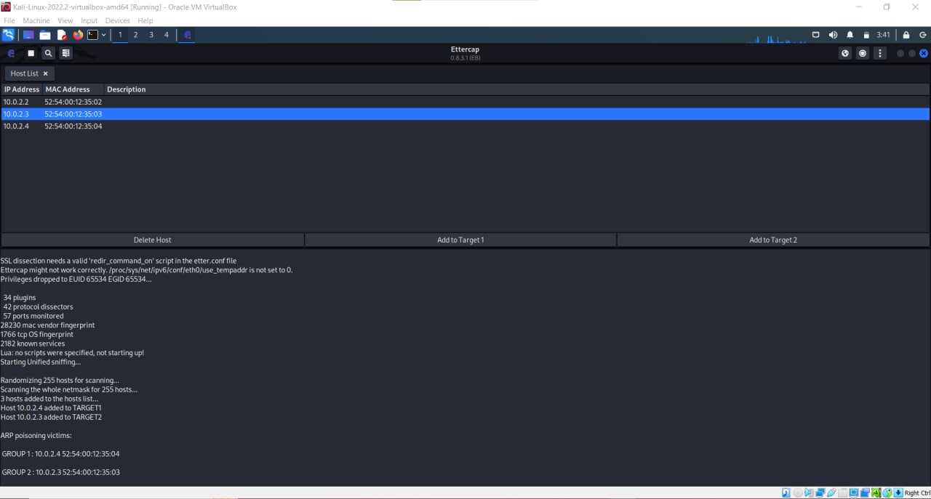
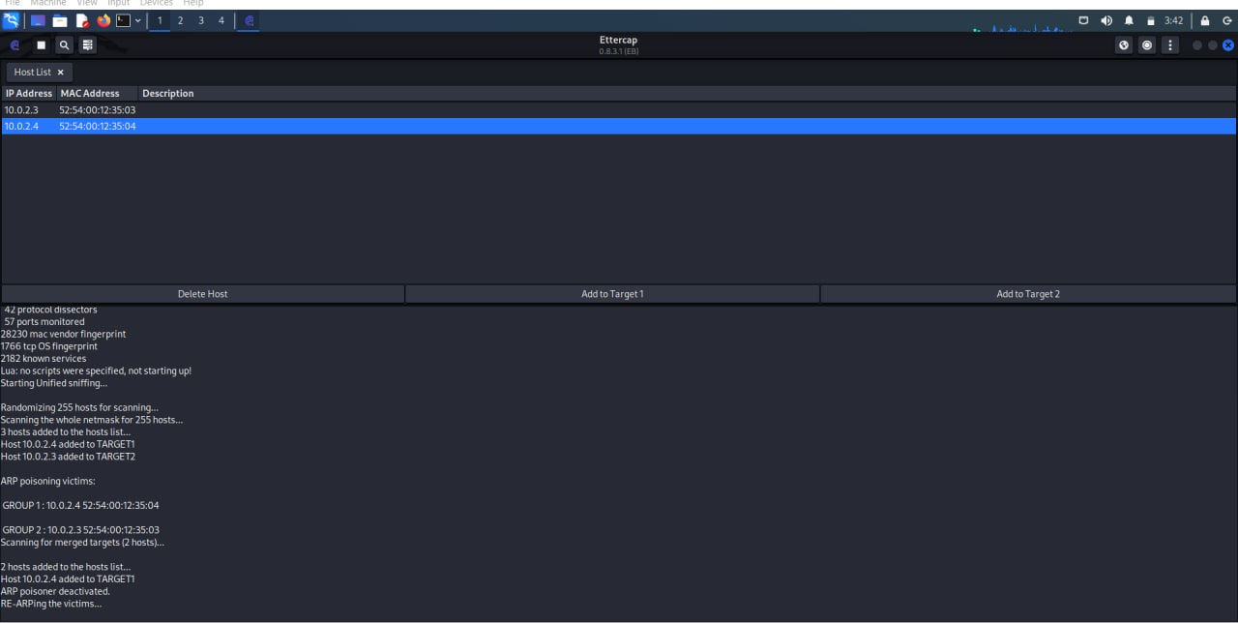
IMPLEMENTATION :

Slide 10
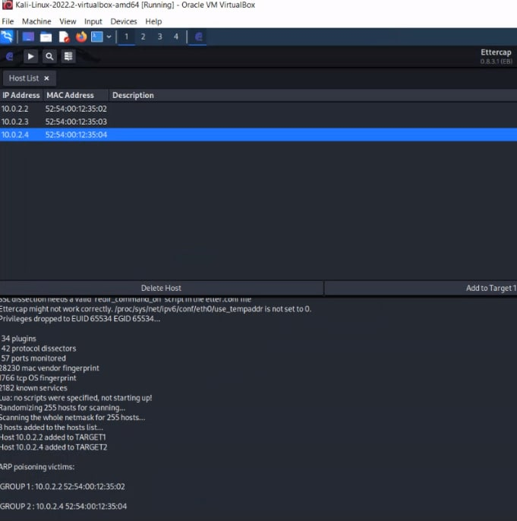

Slide 11
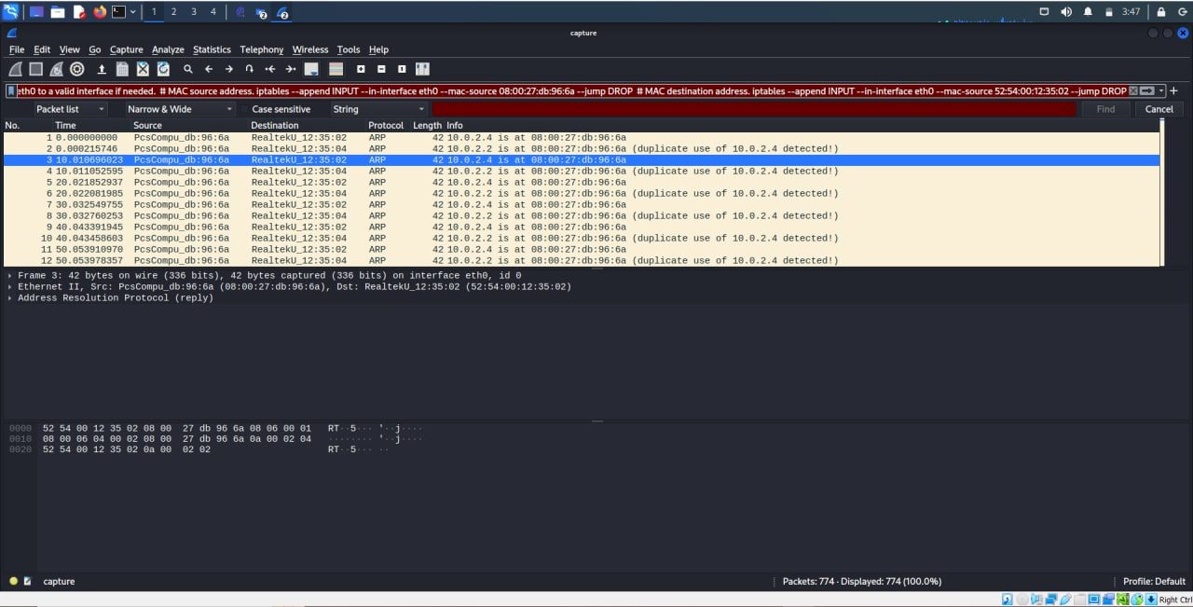
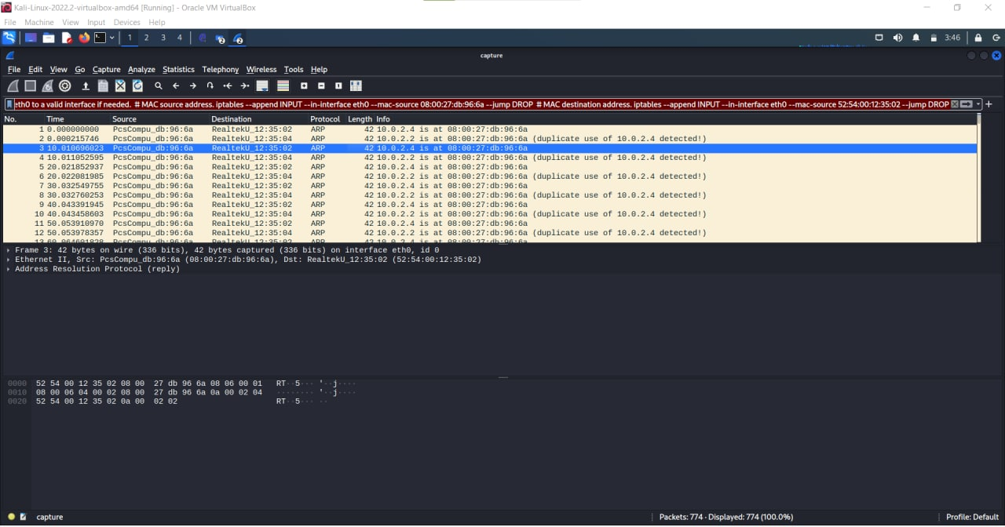
Wireshark capture data:

Slide 12
DNS SPOOFING :
Domain Name Server (DNS) spoofing (a.k.a. DNS cache poisoning) is an attack in which altered DNS records are used to redirect online traffic to a fraudulent website that resembles its intended destination.
Once there, users are prompted to login into (what they believe to be) their account, giving the perpetrator the opportunity to steal their access credentials and other types of sensitive information. Furthermore, the malicious website is often used to install worms or viruses on a user’s computer, giving the perpetrator long-term access to it and the data it stores.

Slide 13
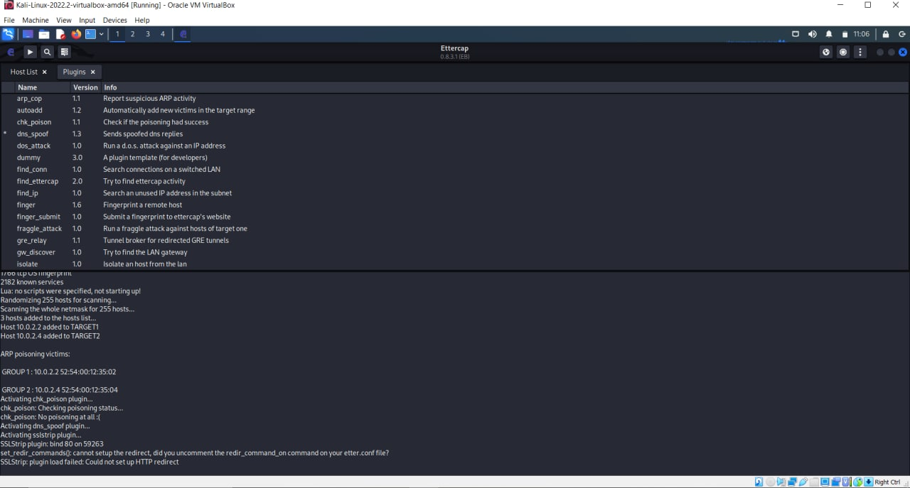

Slide 14
DOS ATTACK :
A Denial-of-Service (DoS) attack is an attack meant to shut down a machine or network, making it inaccessible to its intended users. DoS attacks accomplish this by flooding the target with traffic, or sending it information that triggers a crash. In both instances, the DoS attack deprives legitimate users (i.e. employees, members, or account holders) of the service or resource they expected.

Slide 15
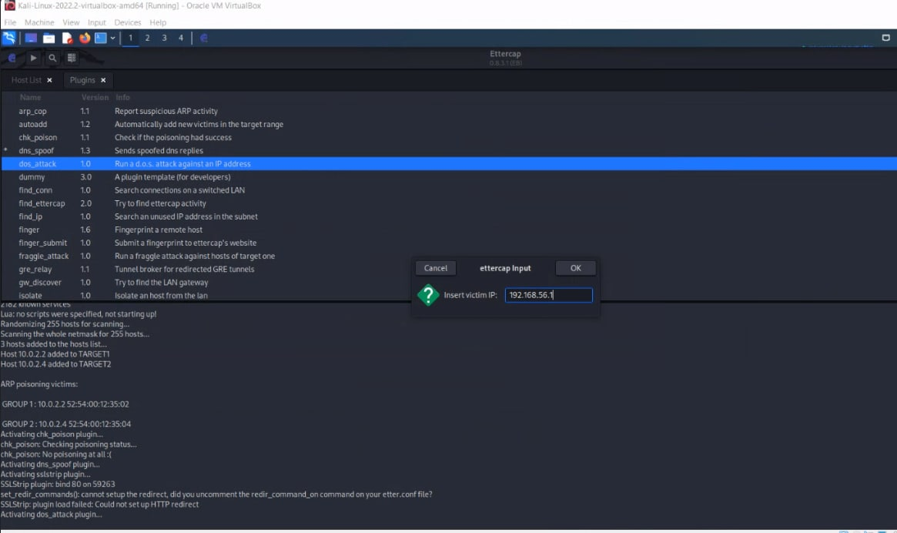
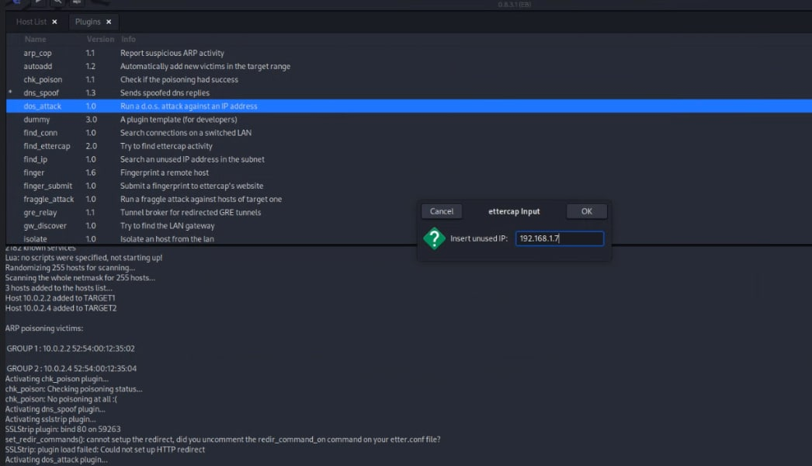

Slide 16
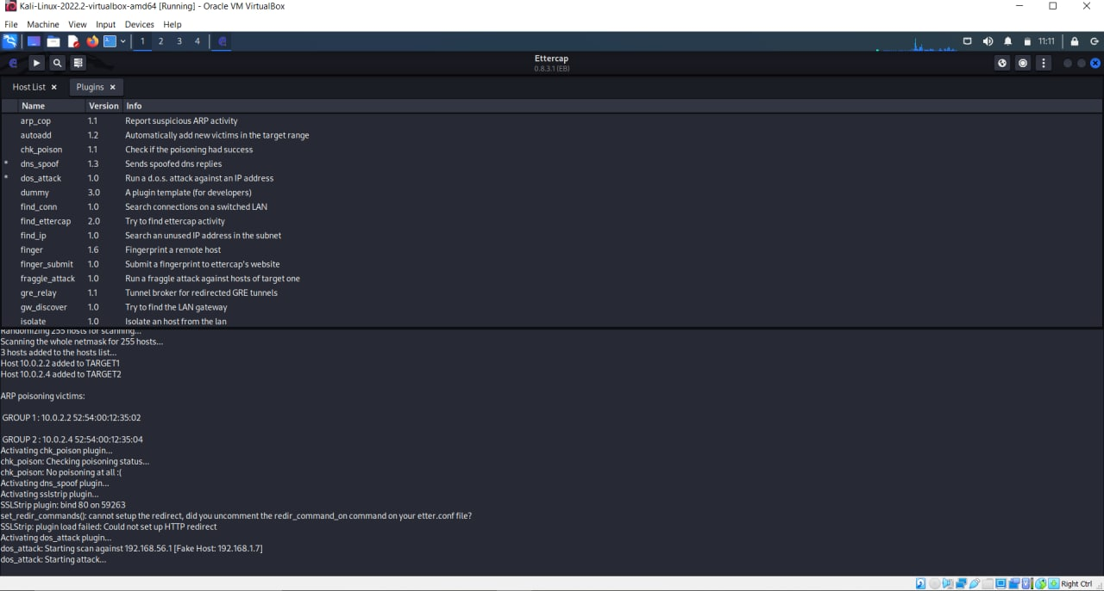
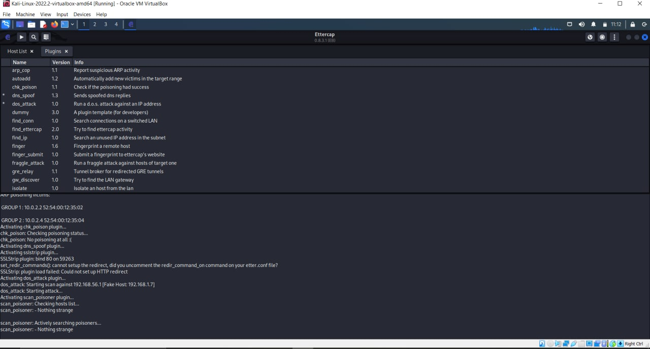

Slide 17
THANK YOU

